Slide 1

Swimming & periods
The worries, the myths, the professionals, the solutions

Slide 2

Your worries/reasonings not to swim?
What are your worries about it…?
Leaking?
Tampons? How to use them? String showing?
Pain
Bloating

Slide 3
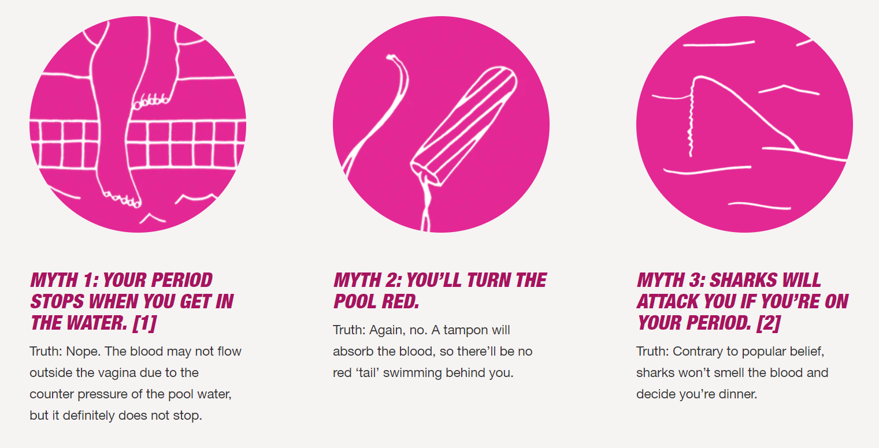
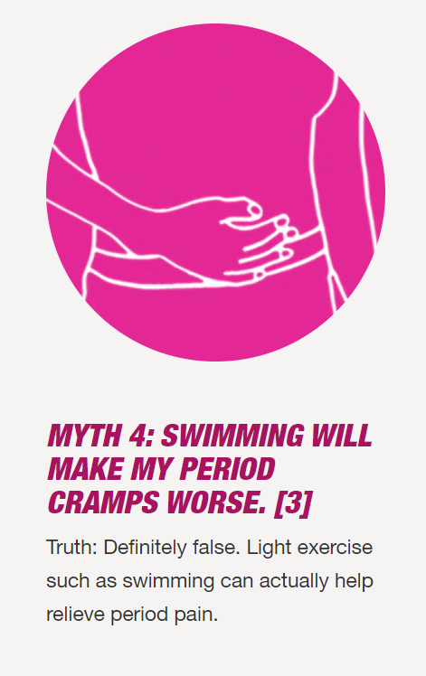
The myths

Slide 4
Leaking in the pool…?
Sanitary towels/pads are not suitable for swimming, they are designed to be very absorbent and will become massive in the pool
Use a tampon (or a menstrual cup)
Swimming without a tampon is a possibility but then leaking is possible

Slide 5

It’s too painful…!
The pain should not stop you from swimming
Ibuprofen or aspirin
Some say exercise helps!
Only you know if you can swim or not

Slide 6
The professionals
Katie Meili, an Olympic bronze and gold medalist in Rio, started swimming competitively at the age of eight and said that while getting your period during a competition can be painful — it doesn’t stop anyone from bringing their A-game. “It’s not an option to not compete. Like anything in life, when you get your period you just have to deal with it and move on.”
Olympic gold medalist Kelsi Worrell: “Nothing is too embarrassing,” said Worrell, “we are so vulnerable with each other and so open, we’re there to help each other out.” Like, for instance, if someone has a visible tampon string. “There are definitely some moments every girl has, especially with the suit,” she said. “Sometimes there’s not much there to cover and you do have a tampon string showing.” That’s when teammates come in handy to do the important work of pointing out a stray string. “Sometimes you’ve just got to help a girl out,” said Worrell.
Catherine Vogt – the head coach of the U.S. women’s open water team in Rio: “I remember being 16 and wondering if someone would see the string coming out. I think it’s all about getting over the initial fear.”

Slide 7
Tampons
Lots of different brands and sizes, with applicators and without
Tampax.co.uk – lots of tips and advice on this website https://tampax.co.uk/en-gb/how-to-use-a-tampon-videos#phdesktopbody_0_phdesktopbrandexperiencecontentarea_1_phbrandexperiencecontentarea70232402b3574e259e3fce1e1ba881c9_5_pnlFlexibleBackgroundImage
https://www.wikihow.com/Use-a-Tampon
Find the brand, type and size that works for you.
If you choose to swim without one, you should get in the water as soon as possible and straight out.

Slide 8
Solutions…
Missing training for a week every month is not going to improve your swimming
Wear a dark coloured swimming suit to make you feel more comfortable
Learn to use tampons
Ibuprofen is the best pain killer for period pain - check if you’re ok to use it.
Trust your team mates to you help you out.

Slide 9
Questions…?
Talk to your team mates, club captain, coaches, mums.
We’re here to help, and have all been through it.
☺

